Slide 1
Abstract Algebra and Cryptography
By: Group 1

Slide 2
Contents
Algebraic Structures, Monoids and Semi-Groups
Group Theory
Ring Theory
Field Theory
Applications of Abstract Algebra in Cryptography

Slide 3
Binary Operations
Let S be a non-empty set, then ⋆ said to be a binary operation on S , if a⋆b is defined for all a,b∈S
Basic binary operations are addition(+), multiplication(*),subtraction(-) and division(/)
E.g. + operation is binary operation for set N, / operation is not a binary operation for set Z

Slide 4
Closure Property
Let S be a non-empty set. A binary operation ⋆ on S is said to be a closed binary operation on S, if a⋆b∈S, ∀a,b∈S.
E.g. The set N is closed under addition and multiplication but not with respect to subtraction and division
The binary operation * on a non-empty set S is a function from S × S to S.
In other words, a binary operation on S is any rule f:S×S→S that assigns exactly one element f(s1,s2)∈S to each pair of elements s1,s2∈S.

Slide 5
Algebraic Structure
The algebraic structure is a type of non-empty set G which is equipped with one or more than one binary operation. Let us assume that * describes the binary operation on non-empty set G. In this case, (G, *) will be known as the algebraic structure if
It follows Closure Property:
e.g.(N,+) is a algebraic structure
(R, +, *) is a type of algebraic structure, which is equipped with two operations (+ and *)

Slide 6
Properties of Algebraic Structures
Commutativity: Suppose set G contains a binary operation * .Binary operation ⋆ on S is said to be commutative, if a⋆b = b⋆a ,∀ a,b∈G.
Associativity : A binary operation ⋆ on S is said to be associative , if
(a⋆b) ⋆ c = a ⋆ (b⋆c) , ∀ a,b,c∈S
Identity : A non-empty set S with binary operation ⋆ , is said to have an identity e∈S , e ⋆ a = a⋆e = a, ∀a ∈ S.
Inverse: Let (S,*) be an algebraic system with identity element e .The element y will be called an inverse of x if x * y = y * x = e where x,y∈S

Slide 7
Semi Group
An algebraic system (S,*) is said to be semi group if it satisfies following conditions:
1) The operation * is a closed operation on G
2) The operation * shows an association operation between a, b, and c that means a*(b*c) = (a*b)*c for all a, b, c in G.
E.g. The algebraic structures (N, + ) , (Z, + ), (Z , * ) are semi groups but the structure ( Z, - ) is not a semigroup because subtraction (-) is not an associative operation.
The algebraic structures (P(S),∪) and (P(S), ∩),where P(S) is the power set of set S is a semi group as union(∪) and intersection are associative operations

Slide 8
Monoid
A monoid is a semigroup, but it contains an extra identity element (E or e). An algebraic structure (G, *) will be known as a monoid if it satisfies the following condition:
○ Closure: G is closed under operation * that means (a*b) belongs to set G for all a, b ∈
○ Associative: Operation * shows an association operation between a, b, and c that means a*(b*c) = (a*b)*c for all a, b, c in G.
○ Identity Element: There must be an identity in set G that means a * e = e * a = a for all x.
E.g. If we will take (Z, *) and (N, +). Where
○ (Z , *) is a monoid because 1 is the identity element which is also an integer.
(N , +) is not monoid as identity element is not present, but it is a semigroup.

Slide 9

Commutative
Abelian Group
Inverse
Group
Identity
Monoid
Associativity
Closure
Semi Group
Algebraic
Group

Slide 10
Groups
Group:-A non-empty set A is said to be a group with respect to a binary operation *,if A satisfies the following properties with respect to * :
Closure property: ‘A’ is said to be closed with respect to *,if ∀a,b∈A, then a*b∈A.
Associativity property: ‘A’ is said to be associative with respect to*,if ∀a,b,c ∈A, then (a*b)*c=a*(b*c).
Identity property: ‘A’ is said to be satisfy identity property with respect to *,if ∀a ∈A, then must be unique e ∈ A, such that a*e=e*a=a
Inverse property: ‘A’ is said to be satisfy inverse property with respect to *,if ∀a ∈A, there must be unique element a-1 ∈ A, such that a* a-1 = a-1 *a=e

Slide 11
Example of Group
Real number R with + (addition):
G1: closure x,y ε R => x+y ε R
G2: Associativity (x+y)+z = x + (y+z)
G3: Identity element 0: x + 0 = 0+x =x
G4: Inverse of x is (-x): x + (-x) = (-x) + x = 0 G5: x +y = y + x

Slide 12
Abelian Group
A non-empty set A is said to be a an Abelian group with respect to a binary operation *,if A satisfy closure, associativity, identity inverse, and commutative property , with respect to *.
1. a*b = b*a
2. P*q=q*p
Note:- Matrices are not followed the Abelian group.
Because of a*b≠ 𝒃 ∗ 𝒂.

Slide 13
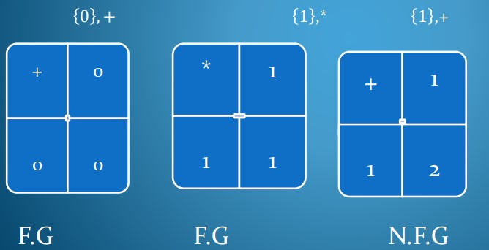
Finite Group
A group with finite number of elements is called finite group.
Examples:

Slide 14




{−1,1, 𝑖, −𝑖} ,∗
𝟏, 𝒘, 𝒘𝟐 ,∗
* | -1 | 1 | i | -i
-1 | 1 | -1 | -i | i
1 | -1 | 1 | i | -i
i | -i | i | -1 | 1
-i | i | -i | 1 | -i
* | 1 | w | w2
1 | 1 | w | w2
w | w | w2 | 1
w2 | w2 | 1 | w
1, 𝑤, 𝑤
2 ,*
−1,1, 𝑖,
−𝑖 ,*

Slide 15
Conclusion:- it is very difficult to design finite group as with number of greater than 2 closure property fails with simple addition and simple multiplication.
So we will try to develop new modified addition and multiplication operators with which closure and other properties can be satisfied

Slide 16
Order of a Group
The order ord(a) of an element a of a group (G,◦) is the smallest positive integer k such that
a
k = a ◦ a ◦. . . ◦ a = 1
k times
where 1 is the identity element of G.
If no such k exists, a is said to have infinite order,
all elements of finite groups have finite order

Slide 17
Example :-
We try to determine the order of a = 3 in the group Z*11
a1= 3
a2 = a · a = 3 · 3 = 9
a3 = a2.· a = 9 · 3 = 27 ≡ 5 mod 11
a4 = a3 · a = 5 · 3 = 15 ≡ 4 mod 11
a5 = a4· a = 4 · 3 = 12 ≡ 1 mod 11
From the last line it follows that ord(3) = 5.

Slide 18
Generator of a Group
An element is called a generator if its order is = number of elements in the group =|G|
A group is cyclic if it contains a generator
Cyclic Group: all the elements in the group can be obtained by repeatedly applying the group operation to a particular group element
A cyclic group can have more than one
generator

Slide 19
Example
(z5, +) is a cyclic group :-
Since 3 ≡ 3 mod 5
3+3 ≡ 1 mod 5
3+3+3 ≡ 9 ≡ 4 mod 5
3+3+3+3 ≡ 12 ≡ 2 mod 5
3+3+3+3+3 ≡ 15 ≡ 0 mod 5
Ord(3) = |G| = 5 => Its a Cyclic Group
So all the group elements {0,1,2,3,4} in Z5 can be generated by 3
3 is also generator for the group Z5.

Slide 20
Cyclic Group
A group (A,*) is said to be a cyclic group if it contains at least one generator.
In a cyclic group if an element ‘a’ is a generator than its inverse will also be a generator.
The order of a cyclic group is always the order of the generating element of G.

Slide 21
Generator
According to Lagrange's Theorem:- let A be a cyclic group of
order n, number of Generator in A is denoted by
∅(𝒏)= {𝒏 (𝒑𝟏 − 𝟏)(𝒑𝟐 − 𝟏)(𝒑𝟑 − 𝟏)… … … … . (𝒑𝒌 − 𝟏)} /(p1p2p3……….pk)
Example:-
Let G be a cyclic Group, of order o(G)= 12, number of Generators in G=??
Solution:-
Given n=12
Different factors=2*2*3
Distinct Prime number=2,3
Here p1=2 and p2=3, and n=12

Slide 22
Applying Lagrange's theorem:-
Number of generators in cyclic group=n(p1-1)(p2-1)/p1.p2
=> 12(2-1)(3-1)/2.3
=> 12.1.2/6
=>24/6
=> 4
So number of generators in cyclic group =4

Slide 23
Note:-
Every cyclic group is commutative but vice versa not true.
Every subgroup of a cyclic group is cyclic.
Every cyclic group(o(G)=prime,o(G)<6) is an Abelian group converse not true.
Every group is a Monoid.

Slide 24
Formal Definition
A non empty set R together with two binary operations ‘+’ and ‘x’ (addition and multiplication) is said to form a ring if
(i) (R,+) is an abelian group.
(ii) (R,x) is an semi group(Associativity).
a x (b x c) = (a x b) x c ∀ a,b,c ∈ R
(iii) Distributive Law
a x (b + c) = (a x b) + (a x c) ∀ a,b,c ∈ R
(a + b) x c = (a x c) + (b x c) ∀ a,b,c ∈ R
(R,+,x) is a Ring.
The ring R is commutative if multiplication is commutative.
The ring R is said to have an identity if there is an element 1 ∈ R
1 x a = a x 1 = a ∀ a ∈ R

Slide 25
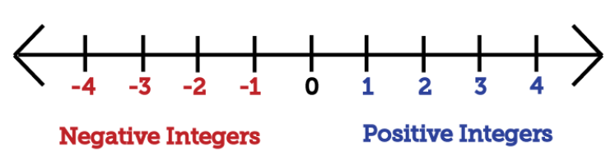
Example of Ring
Proof (Z,+,x) is a Ring.
Consider a number line,
‘+’ is a binary operation
a+b ∈ Z ∀ a,b,c ∈ Z
‘x’ is a binary operation
axb ∈ Z ∀ a,b,c ∈ Z
(i) (Z,+) is an abelian group.
(a) Associativity → a+(b+c) = (a+b)+c → 1+(2+3) = (1+2)+3 ∀ a,b,c ∈ Z
(b) Additive Identity → a+0=0+a → 1+0=0+1 ∀ a ∈ Z
(c) Additive Inverse → a+(-a)=(-a)+a → 1+(-1)=(-1)+(1) ∀ a ∈ Z
(d) Commutative → a+b=b+a → 1+2=2+1 ∀ a,b ∈ Z

Slide 26
Example of Ring
(ii) (Z,x) is a semi group.
(a x b) x c = a x (b x c) → (2 x 3) x 5 = 2 x (3 x 5) ∀ a,b,c ∈ Z
(iii) Distributive Law
a x (b + c) = (a x b) + (a x c) → 1x(2+3) = (1x2)+(1x3) ∀ a,b,c ∈ Z
(a + b) x c = (a x c) + (b x c) → (1+2)x3 = (1x3)+(1x2) ∀ a,b,c ∈ Z
Some more examples of a Ring:
(Q,+,x) is a Ring.
(IR,+,x) is a Ring.
(C,+,x) is a Ring.

Slide 27
Zero Divisor
Definition: An element 0≠a∈R is set a zero divisor if there exist 0≠b∈R such that ab=0 or ba=0
Note:
(i) If a is a zero divisor of R then b is also a zero divisor of R
(ii) R may have zero divisor or may not have zero divisor
Example: A Matrix M,
M = | a11 a12 | a11,a12,a21,a22 ∈ Z
| a21 a22 |
where , (M,+,x) is a Ring

Slide 28
Zero Divisor (Cont.)
m1 = 0 1 ≠ 0 0 ∈ M
0 0 0 0
Such that there exist,
m2 = 0 2 ≠ 0 0 ∈ M
0 0 0 0
Such that,
0 1 x 0 2 = 0 0
0 0 0 0 0 0
Therefore M has zero divisor

Slide 29
Integral Domain
Definition: A commutative ring R with identity 1 ≠ 0 is called Integral Domain if it has no zero divisors.
Example: R = Z → set of integers
(Z,+,x) is a Ring.
(Z,+,x) is a commutative ring.
∀ a,b ∈ Z
ab = 0 if a=0 or b=0
3x5 = 15, 7x5=35

Slide 30
Division Ring
Definition: A ring R with unity is called a division ring if all non zero elements of R are invertible i.e all elements except zero have multiplicative inverse.
Example:
Consider the set of all real numbers except 0, denoted by R* with the usual addition and multiplication operations. This set forms a division ring.
The set R* is a ring because it is closed under addition and multiplication, and these operations satisfy the ring axioms. Now, let's check that R* is a division ring:
Addition and multiplication closure: The set is closed under addition and multiplication since it consists of all real numbers except 0.
Additive identity and inverses: The additive identity is 0, and every element has an additive inverse
Multiplicative identity: The multiplicative identity is 1.
Multiplicative inverses: Every nonzero element a∈R has a multiplicative inverse
a(inverse of -1) = 1/a except for 0.
Associativity of multiplication: Multiplication is associative for real numbers.

Slide 31
Subring
Definition: A subring of the ring R is a subgroup of R that is closed under multiplication.
In other words, a subset S of a ring R is a subring if the operations of addition and multiplication in R when restricted to S give S the structure of the ring. To show that a subset of a ring R is a subring if suffices to check that it is nonempty and closed under subtraction and under multiplication.
Example:
→ Let's consider the ring of integers Z. One example of a subring is the set of all even integers 2Z.
→ The set 2Z consists of all integers of the form 2k, where k is an integer. In other words:
2Z={…,−4,−2,0,2,4,…}
Closure under Addition and Multiplication:
If a,b are even integers (a=2m and b=2n), then a+b=2m+2n=2(m+n) is also an even integer.
If a,b are even integers, then a⋅b=2m⋅2n=4mn=2(2mn) is also an even integer.
Contains the Additive Identity:
The additive identity in Z is 0, and is an even integer.
Closed under Negation:
If a is an even integer (a=2m), then −a=−2m is also an even integer.
Closed under Subtraction:
If a,b are even integers, then a−b=2m−2n=2(m−n) is also an even integer.
Forms a Ring:
The set 2Z forms a ring with the usual addition and multiplication operations. It is closed under these operations, and it is an additive group with the additive identity, inverses, and associativity of addition.
Therefore, 2Z is a subring of the ring of integers Z.

Slide 32
Field
A set F, (F,+,∘) is a field if
(F,+) is an abelian group
With 0 being the neutral element of addition.
(F∖{0},∘) is an abelian group too.
Multiplication distributes over addition
∀a,b,c∈F a(b+c)=ab+ac

Slide 33
Field
These properties can be satisfied if field size is prime number or integer power of a prime number.
Order of the field: The number of elements in the set is called the order of the field.
Represent a Field (Prime size field):
GF(P): P represent the number of elements in the field or order of the field. So the elements are : {0, 1 ……N-1} or MOD N

Slide 34
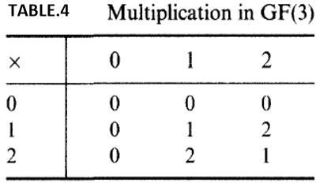
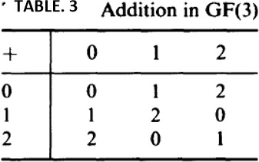
Field Example
Example1 : GF(3)
Additive identity is 0 and multiplicative iden³ tity is 1.Inverse exist for all the elements.
A ﬁeld with order m exists iﬀ m is a prime power.
i.e. m = p^{n}, for some n and prime p
and p is the characteristic of the finite field

Slide 35
Types of Finite Field
GF (P^{m})
m>1
m=1
GF (P^{m})
GF (P¹)
Extension Filed
Imp. In crypto esp. GF(2^{m} )
Prime Field (Galois Field)
Identify which is field?
GF(5) ??
GF (12) ??
Solution :
Yes
No, bcoz 12 is not a prime number
A Galois field, GF(p^{n}), is a finite field with p^{n} elements (Finite elements)

Slide 36
Why prime numbers only?
if a number p is not prime, then some numbers won't have multiplicative inverses modulo p
Example:
There is no integer a such that 2×a=1(mod6).
So the integers modulo p or modulo 6
(GF(6)) don't actually form a field (but only a ring) unless m is prime.

Slide 37
Prime Field Arithmetic
The element of a prime field GF(p) are from the set { 0, 1, 2,…….p-1} and arithmetic in GF(p) is done modulo p
Add, subtract, multiply and division Let a, b ε GF(p) = { 0 ,1,2….p-1}
a+ b Ξ c mod p a – b Ξ d mod p
a. b Ξ c mod p
a. a⁻¹ Ξ 1 mod p
All the conditions of field are satisfied.

Slide 38
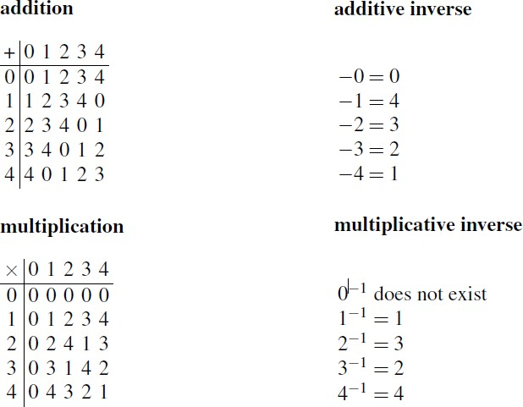
Prime Field
Let’s take GF(5) = {0,1,2,3,4}

Slide 39
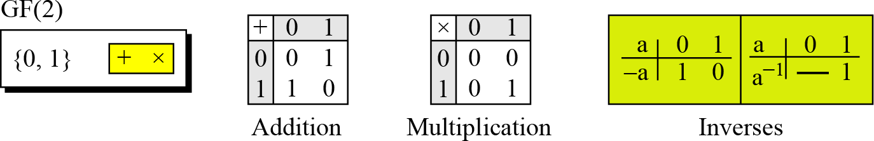
Prime Field
A very important prime field is GF(2), which is the smallest finite field that exists
GF(2)={0,1}
XOR Gate
AND Gate

Slide 40
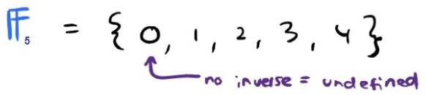

Prime Field
Example:
When referring to finite fields as F* means 0 is not included as part of the set

Slide 41
Extension Field
Fields with m > 1 are called extension fields (p^{m})
i.e. elements from (0… p^{m}-1)
If the order of the field is not prime then operations in (mod p) are not possible
The addition and multiplication operation (Mod p) will be easy if:
a different notation for field elements (Polynomials)
different rules for performing arithmetic with the elements (Polynomial arithmetic)

Slide 42
Extension Field
An element A(x) in an field GF(p^{m}) is described by a polynomial as follows:
A(x) = a₀ + a₁x+……………………a_{m-1}x^{m-1} where a_{i}∈GF(p)
The elements of GF(2³) are polynomials: A(x) = a₀ + a₁x+a₂x³⁻¹ where a_{i}∈GF(2)
a ε GF(2) = { 0, 1}
{0, 1, x, x+1, x², x²+1, x²+x, x²+x+1}
The highest exponent of the variable X is called the degree of the polynomial

Slide 43
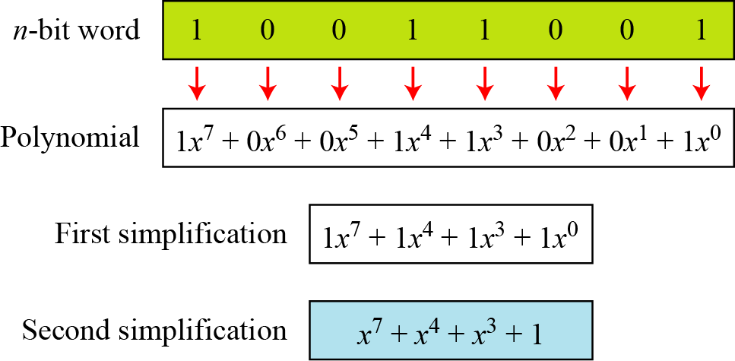
Polynomial Example
How we can represent the 8-bit word (10011001) using a polynomials.

Slide 44
Arithmetic Operations in Extension Field
How to compute with these elements? Add, subtract in GF(2^{m})
Use regular polynomial addition or subtraction where coefficients are computed in GF(2)
Example: GF(2³) A(x)= 1+x+x^{2,} A(x) + B(x) = 0 + x + 0 = x
B(x)= 1+x² ε GF(2³)
Note: Addition and subtraction operation are same in GF(2^{m}) as mod 2
-1 ≡ 1

Slide 45
The multiplication sometimes give terms of order x^{n} or higher
That's why there's another step: after the multiplication, reduce the result modulo a suitable polynomial (specifically, an Irreducible Polynomial of order n).

Slide 46
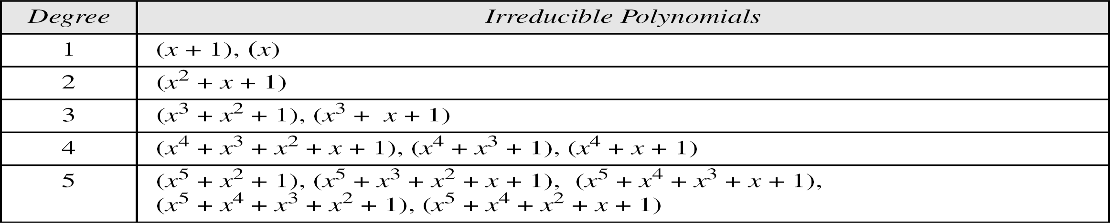
Irreducible Polynomial
Irreducible polynomial is a polynomial that cannot be factored into lower-degree polynomials
1 + X + X² is an irreducible polynomial, since neither X nor X + 1 are its factors

Slide 47
Use of Irreducible Polynomial
when an algebraic operation –obviously polynomial multiplication — results in a polynomial whose degree equals or exceeds that of the irreducible polynomial, we will take for our result the remainder modulo the irreducible polynomial

Slide 48
Example
(x ² + x + 1) × (x ² + 1) mod (x ³ + x + 1) in GF(2^3)
= (x ⁴ + x ³ + x ² ) + (x ² + x + 1) mod (x ³ + x + 1)
= (x ⁴ + x ³ + x + 1) mod (x ³ + x + 1)
= − x ² − x = x ² + x (Remainder) (x+1) is quotient
So (x ² + x + 1) × (x ² + 1) = (x+1) in GF(2^3)
Imp: Every coefficient must belong to GF(2)

Slide 49
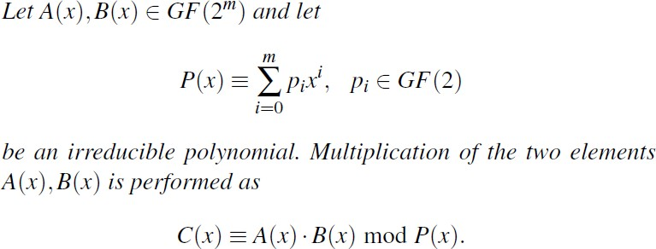
Extension field multiplication

Slide 50
GF(4) or GF(2² ) or F₄ is the finite field of order 4. It is not the same as Z₄ i.e. the integers modulo 4
Z₄ is not a field
GF(2² ) maps all of the polynomials over GF(2) to the four polynomials not the integers
It is important not to confuse multiplication in
GF(2^{m}) with integer multiplication

Slide 51
An element of GF(2⁸) is a polynomial of degree less than 8 over GF(2) (with coefficients in GF(2)) modulo an irreducible polynomial of degree 8

Slide 52
Galois Field Construction
General procedure for constructing a finite field with p^{n} elements, where p is prime and n
1. let Z_{p} denote the integers mod p
Z_{p}[X] is the set of polynomials with coefficients mod p
Choose P ( X ) to be an irreducible polynomial mod p of degree n
Let GF (p^{n}) be Z_{p}[X] mod P ( X) . Then GF (p^{n}) is a field with p^{n} elements.

Slide 53
Example to check whether an element belong to a field or not?
Given A[x]= X ⁴ + X ³ +1 , prove A[x]ε GF(2²)
Choose P(x) (irreducible polynomial) of degree 2= X ² + X +1
Z_{p}[X] mod P(x) = (X ⁴ + X ³ +1 ) mod P(x) = X
Whenever we divide by X ² + X +1 we can obtain a remainder that is
either 0 or a polynomial of degree a t most 1 (if the remainder had degree 2 or more, we could continue dividing). Therefore, we define Z₂[X] (mod X ² + X +1 ) to be the set {0,1, x, x + 1} of polynomials of degree at most 1, since these are the remainders that we obtain when we divide by X ² + X +1

Slide 54
Concept
All the AES arithmetic is based on GF(2⁸ ). It uses the following irreducible polynomial
x ⁸ + x ⁴ + x ³ + x + 1
The finite field GF(2⁸ ) used by AES contains 256 distinct polynomials over GF(2)

Slide 55
Concept
So far we have talked about operations for implementing the addition, the subtraction, and the multiplication operations for the bit patterns in GF(2^{n} )
What about division?
Same as calculating inverse

Slide 56
Concept
Additive inverse is not a problem: In GF(2^{m}) every element is its own additive inverse
Multiplicative inverse in a Field: For a given finite field GF(2^{m}) and the corresponding irreducible reduction polynomial P(x), the inverse A⁻¹ of a nonzero element A ∈ GF(2^{m}) is defined as:
A (x) ·A ⁻¹(x) =1 mod P(x)

Slide 57
Applications of Abstract Algebra
1. Number Theory and Modular Arithmetic:
Number theory, a branch of abstract algebra, provides the foundation for many cryptographic systems. Concepts like prime numbers, modular arithmetic, and integer factorization are crucial in constructing algorithms for encryption, decryption, and digital signatures. For instance, the widely used RSA algorithm relies on the difficulty of factoring large prime numbers.
2. Group Theory:
Group theory, another branch of abstract algebra, is essential in designing secure cryptographic protocols. Groups provide a structured framework for understanding and manipulating mathematical operations, such as addition and multiplication, within finite sets. This is particularly important in public-key cryptography, where the security of algorithms hinges on the properties of certain mathematical groups.

Slide 58
3. Finite Fields:
Finite fields, also known as Galois fields, are specific types of algebraic structures that play a critical role in modern cryptography. They are used in algorithms like the Advanced Encryption Standard (AES) and the Elliptic Curve Digital Signature Algorithm (ECDSA). Finite fields provide a compact and computationally efficient setting for performing cryptographic operations.
4. Elliptic Curve Cryptography:
Elliptic curve cryptography (ECC) is a highly secure and efficient form of public-key cryptography that utilizes the mathematical properties of elliptic curves. These curves are geometric structures defined over finite fields and possess unique properties that make them well-suited for cryptographic applications.

Slide 59
5. Hash Functions:
Hash functions are algorithms that map data of any size to a fixed-length output, known as a hash value. Abstract algebra provides the mathematical tools to design and analyze secure hash functions. These functions are crucial for digital signatures, message authentication, and cryptographic protocols.
6. Error-Correcting Codes:
Error-correcting codes are techniques used to detect and correct errors that may occur during data transmission or storage. Abstract algebra provides the mathematical framework for constructing and analyzing error-correcting codes. These codes are essential in ensuring the integrity of data in secure communication systems.

Slide 60
7. Digital Signatures:
Digital signatures are a mechanism for verifying the authenticity and integrity of digital messages. Abstract algebra provides the mathematical tools to design and analyze secure digital signature schemes. These schemes rely on concepts like modular arithmetic and public-key cryptography to ensure the trustworthiness of digital documents.
8. Key Exchange Protocols:
Key exchange protocols are methods for securely establishing shared secret keys between parties in a communication network. Abstract algebra is crucial for designing and analyzing secure key exchange protocols. These protocols rely on concepts like public-key cryptography and finite fields to protect sensitive information from eavesdropping and unauthorized access.

Slide 61
THANK YOU

